Slide 1
Story Telling and Professional Writing
Technical Report Writing BITS F112

Slide 2
Objective: What insights can be drawn from storytelling for professional writing.
Humans as storytellers
Storytelling as communications
Elements in a story
Professional communication as storytelling

Slide 3
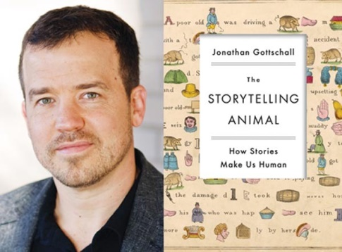
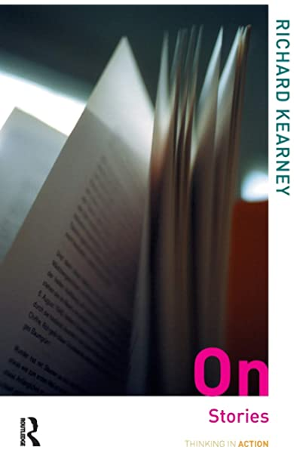
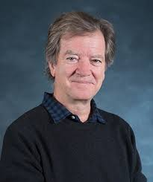
1. Humans as storytellers >>
‘Humans are natural storytellers; they cannot help telling stories…’ – Jonathan Gottschall
Telling stories is as basic to human beings as eating. More so, in fact, for while food makes us live, stories are what make our lives worth living. They are what makes our condition human – Richard Kearney

Slide 4
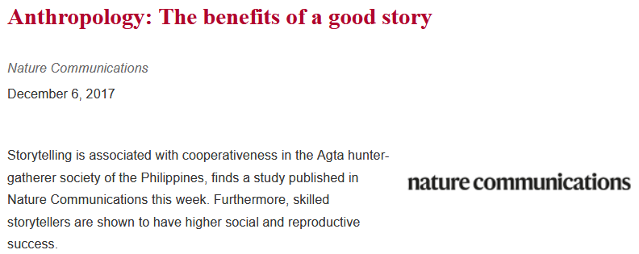
1. Human as storytellers >>
Why do humans tell stories?
Survival
‘Stories helped us survive, so our brains evolved to love them’ – Anna Clemens
Builds society
‘You can learn a lot from a tale like that — about friendship, cooperation, empathy and an aversion to inequality…’ – Daniel Smith, Anthropologist

Slide 5
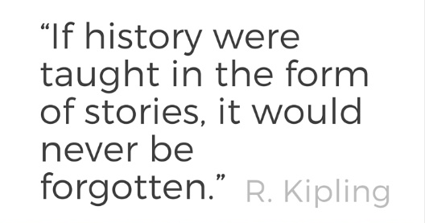
1. Human as storytellers >>
Why do humans tell stories?
Connects with our emotions
‘… once hooked by a story, our brain releases oxytocin… ‘You could say stories are a shortcut to our emotions’ – Paul Zak, Psychologist
Enables learning

Slide 6
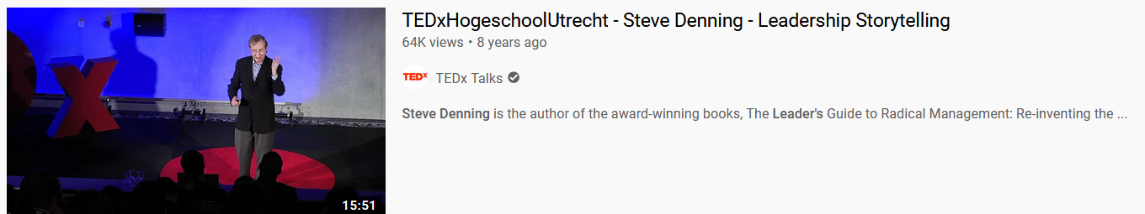
2. Storytelling as communication >>
Stories as mediums to convey a message
‘…everything — faith, love and even science need a story for people to find it plausible’ – Jonathan Gottschall interview with New Yorker.
Reasons and Evidence don’t always work!
“…Slides leave listeners dazed. Prose remains unread. Reasons don’t change behavior. When it comes to inspiring people to embrace some strange new change in behavior, storytelling isn’t just better than the other tools. It’s the only thing that works” – Steve Denning, Leadership and management consultant

Slide 7
3. The elements in a story >>
The plot
The blueprint of the story
The manner in which the events and actions are rendered in a narrative.
The plot has a beginning, a middle and an end
Note: the similarity with writing; an essay having an introduction, a body and a conclusion.

Slide 8
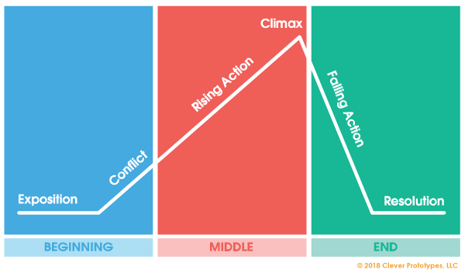
3. The elements in a story >>
The plot
Exposition
Rising action
Climax
Falling action
Resolution
Stories also contain
A point of view
Theme

Slide 9
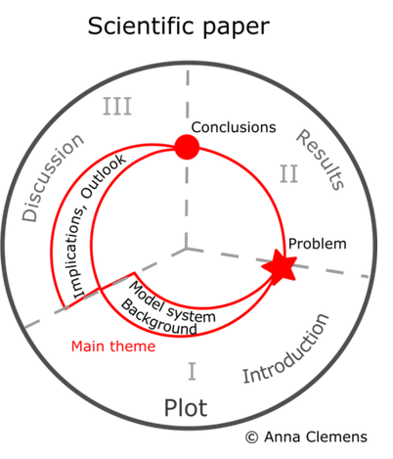
4. Professional communication as storytelling >>
In academic/professional writing
Character become the topic that is researched or focused on
Conflict/tension becomes the research problem
Setting constitutes the background to the topic and the problem
Climax is replaced with a conclusion where results or findings are shown
Resolution becomes the discussion where the relevance of results to understanding or solving the problem is demonstrated
Source: Clemens, A (n.d.) How to use story-telling in scientific writing. Online: https://www.annaclemens.com/blog/story-telling-scientific-paper (Accessed on 25 Oct 2020)

Slide 10
4. Professional communication as storytelling >>
Source: Clemens, A (n.d.) How to use story-telling in scientific writing. Online: https://www.annaclemens.com/blog/story-telling-scientific-paper (Accessed on 25 Oct 2020)

Slide 11
References
Clemens, A (n.d.) How to use story-telling in scientific writing. Online: https://www.annaclemens.com/blog/story-telling-scientific-paper (Accessed on 25 Oct 2020)
Enago Academy (2019) Storytelling in Science: Communicate Your Research in Style. Accessed online: https://www.enago.com/academy/storytelling-in-science-communicating-your-research-effectively/ [On 5 Dec 2019]
Gopnik, A. (2012) Can Science Explain Why We Tell Stories? The New Yorker. Accessed online: https://www.newyorker.com/books/page-turner/can-science-explain-why-we-tell-stories [On 5 Dec 2019]
Gottschall, J (2012) The Storytelling Animal: How Stories Make us Human. Houghton Mifflin Harcourt.
Kluger K (2017) How Telling Stories Makes Us Human, in Time. Accessed online: https://time.com/5043166/storytelling-evolution/ [Accessed on 25 Oct 2020]
Konnikova, M (2012) The Storytelling Animal: A Conversation with Jonathan Gottschall in the Scientific American. Accessed online: https://blogs.scientificamerican.com/literally-psyched/the-storytelling-animal-a-conversation-with-jonathan-gottschall/ [25 October 2020]

